Slide 1



H₂
Post-Market Launch Patent Analysis for Fire-Proofing Hydrogen Cell Vehicles Companies
Dequn Teng, Miaomiao Zou, Chen Ye, Can Cui
2nd Mar 2022

Slide 2
01 Company Background Assumptions
02 Analysis Strategy 03 Possible Partners 04 Our Suggestions 05 Future Plan
06 Limitations & Challenges
Content

Slide 3
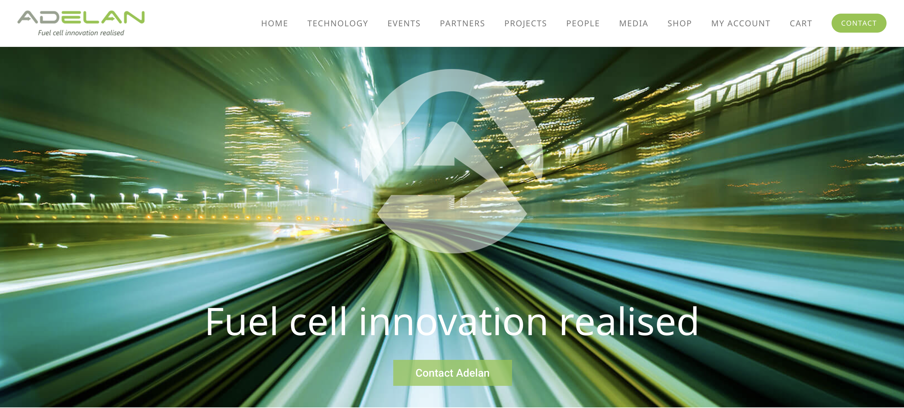
Company Background Assumption
Adelan: Building the hydrogen
economy for 25 years
We are leading the UK hydrogen economy to deliver clean air. The founders of Adelan [Est. 1996] – Professor Kevin Kendall FRS and Dr Michaela Kendall – invented the core microtubular solid oxide fuel cell (mSOFC) technology in 1992.
Adelan develops low carbon products for the clean energy market and offers unique fuel cell system sales and strategic partnership to customers looking to decarbonise.
We are looking for fire-proofing companies in hydrogen fuel cell
Birmingham, United Kingdom
https://adelan.co.uk/

Slide 4
Analysis Strategy
Strategy 01
Focus on ”Big Company”
Unless otherwise specified, “Private Owner” and “Next” are both ruled out
Strategy 02
Self-Definition
Who we are
Evaluation system
Strategy 03
Analysis criteria
CPC Code
Geographic Distribution
Patents Citations
Age of Patent Portfolios
PVIX

Slide 5
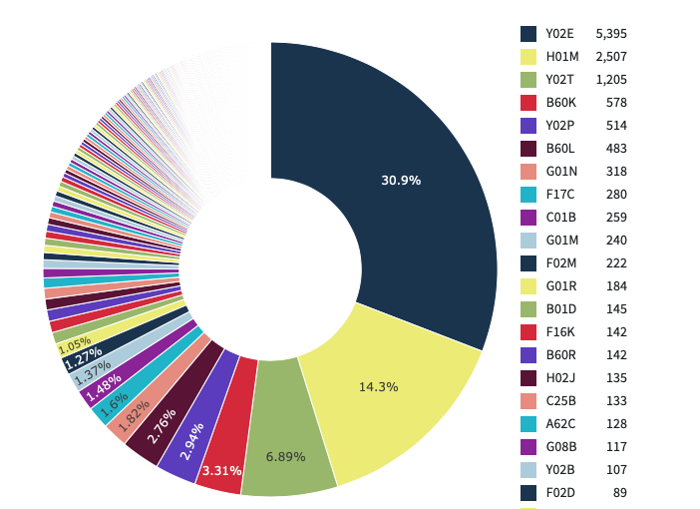
Five Selected CPC
Y02E | Reduction of greenhouse gas emissions, related to energy generation, transmission or distribution
H01M | Processes or means, e.g. Batteries, for the direct conversion of chemical energy into electrical energy
Y02T | Climate change mitigation technologies related to transportation
B60K | Arrangement or mounting of propulsion units or of transmissions in vehicles; arrangement or mounting of plural diverse prime-movers in vehicles; auxiliary drives for vehicles; instrumentation or dashboards for vehicles; arrangements in connection with cooling, air intake, gas exhaust or fuel supply of propulsion units in vehicles
Y02P | Climate change mitigation technologies in the production or processing of goods
The top five accounted for around 60%

Slide 6
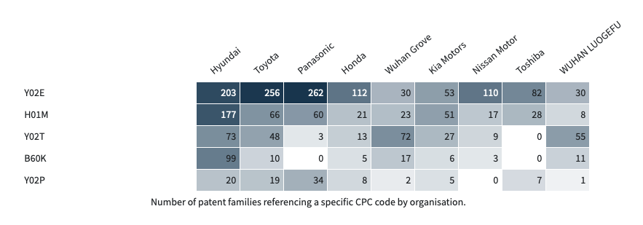
Our partners based on CPC
Table: Number of patent families referencing a specific CPC code by organization.
Selection Criteria
>100
>50
>40
>=10
>=10
Total
5
5
3
1
2
1
1
0
2
Conclusion
All-rounder companies: Hyundai & Toyota
Expert in Y02T: Wuhan Grove
Expert in Y02P: Panasonic

Slide 7
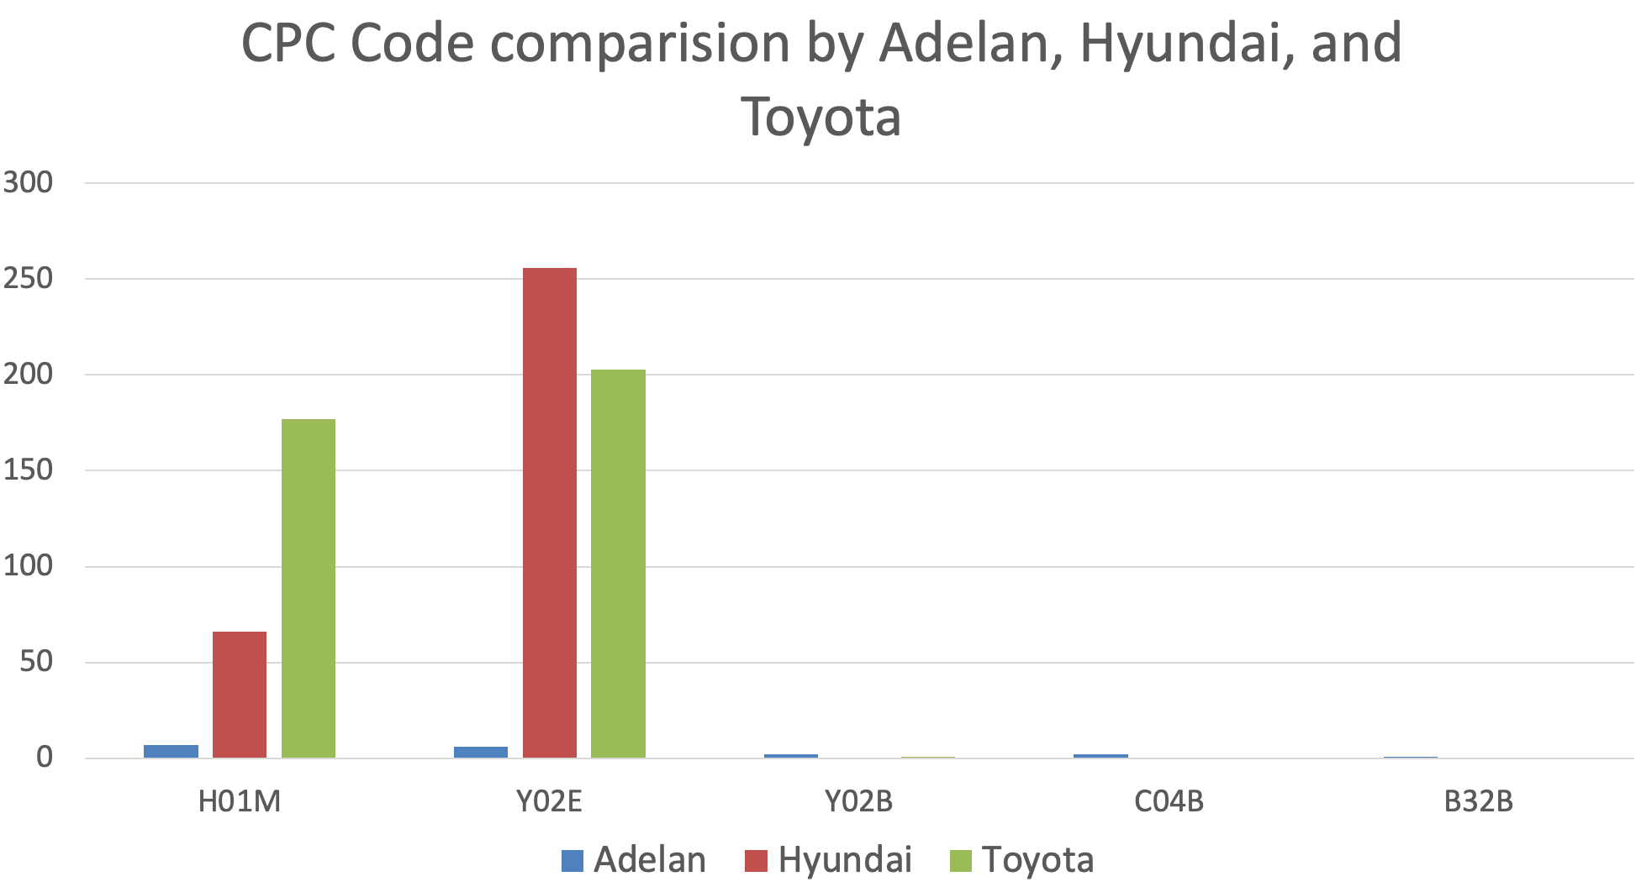
Our partners based on CPC
Patent by CPC by orgs
Proportion calculation
Difference calculation
Normalization and *5
CPC Code Pencentage | Adelan | Toyota | Hyundai
H01M | 39% | 20% | 46%
Y02E | 33% | 80% | 53%
Y02B | 11% | 0% | 0%
C04B | 11% | 0% | 0%
B32B | 6% | 0% | 0%
Score
3.6
1.8
*Hyundai has a higher similarity with Adelan.
How to choose?
Complementary Companies:
Technology Complementation
Similar Companies:
More advanced technologies
“Expert” Companies:
Specified technologies

Slide 8
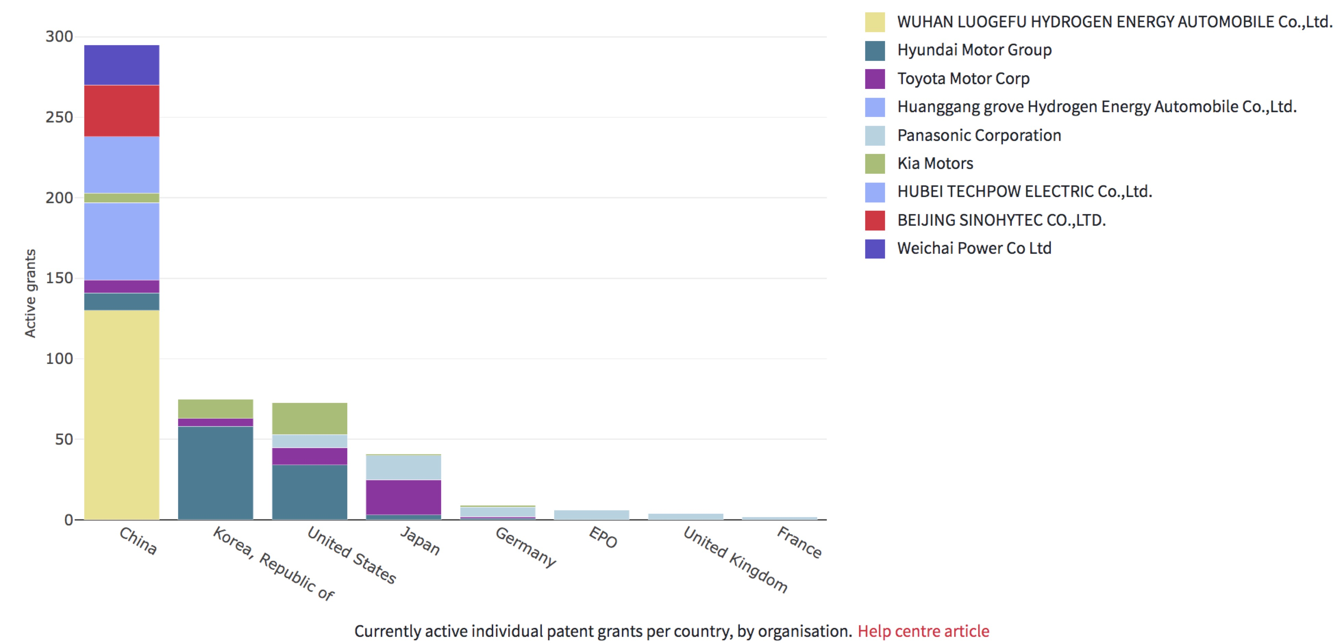
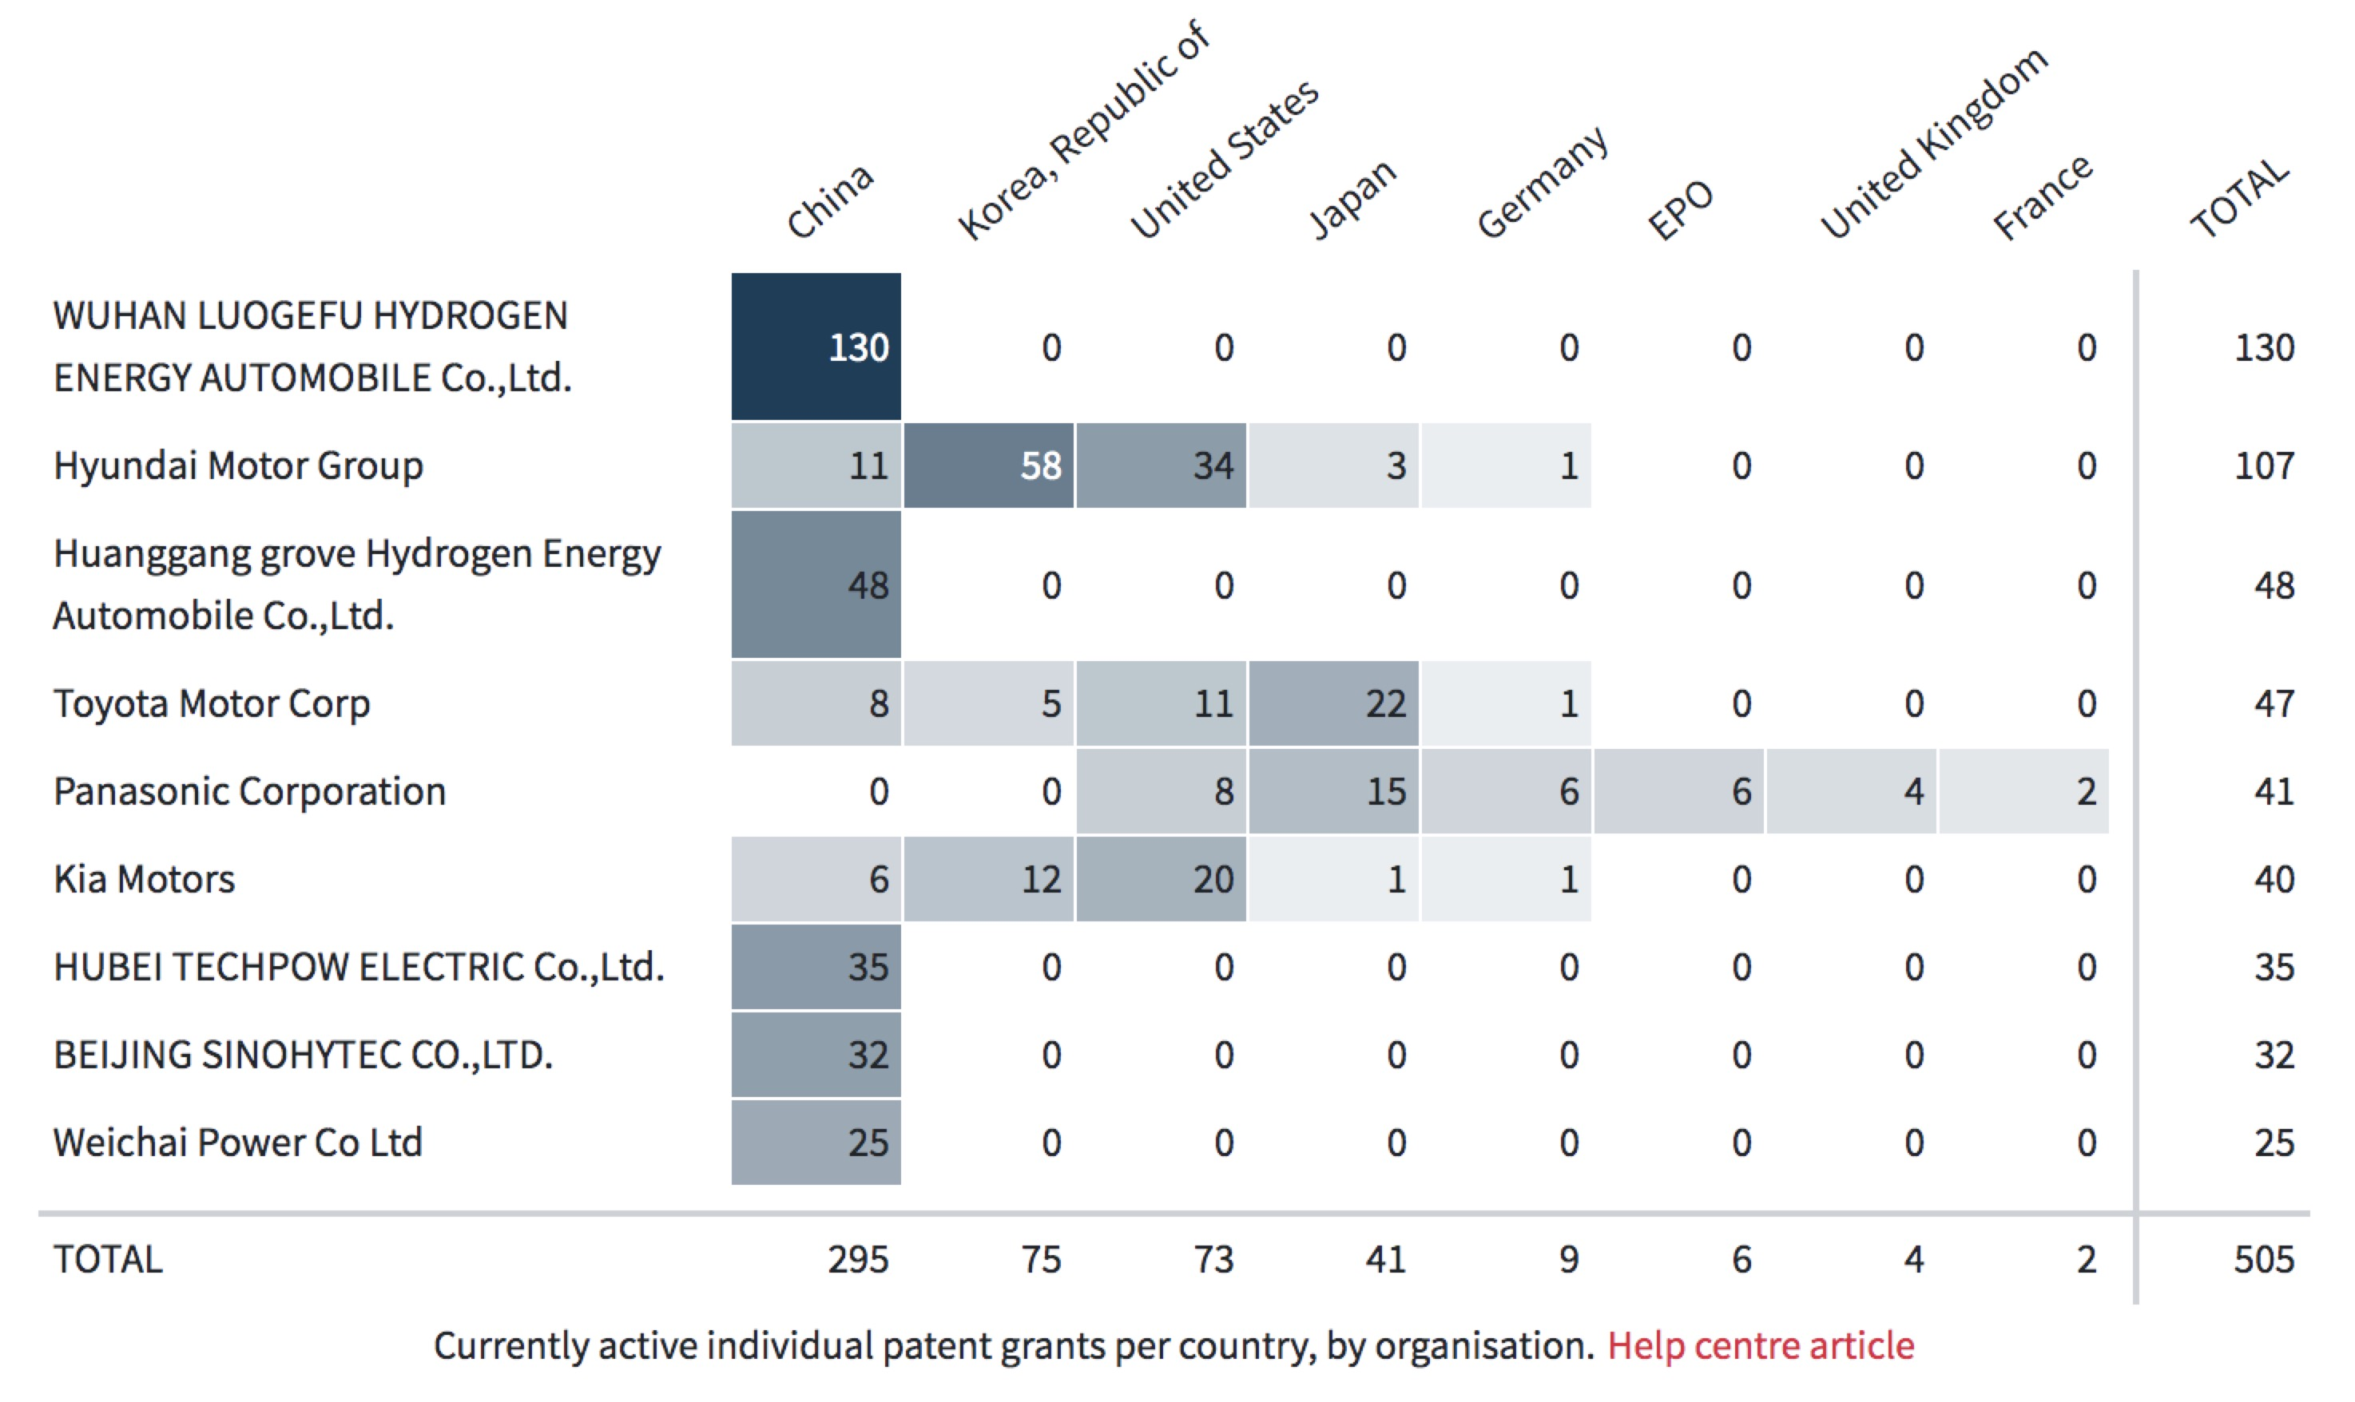
Our partners based on Geographic Distribution
Priority day in 10 years
Weight: 0.7 | Active grants in ≥ 5 countries | 5 > Active grants in ≥ 4 countries | 4 > Active grants in ≥ 3 countries | 3 > Active grants in ≥ 2 countries | 2 > Active grants in ≥ 1 countries
Country score | 5 | 4 | 3 | 2 | 1
Weight: 0.3 | Active grants ≥ 50 | 50 > Active grants ≥ 45 | 45 > Active grants ≥ 40 | 40 > Active grants ≥ 35 | 45 > Active grants ≥ 30
Patent score | 5 | 4 | 3 | 2 | 1
Figure 1 & Table 1. Current active individual patent grans per country, by organizations
 | Hyundai | Toyota | Panasonic | Kia | Wuhan Luogefu
Total score | 5 | 4.7 | 4.4 | 4.4 | 2.2
Rank | 1 | 2 | 3 | 4 | 5
Formula: Total score= Weight1 x country score+ Weight2 x patent score
*The rank is based more on the number of countries and less on the number of patents.

Slide 9
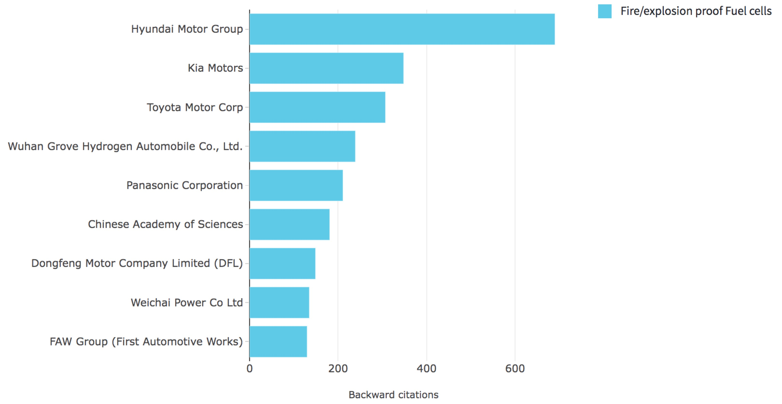
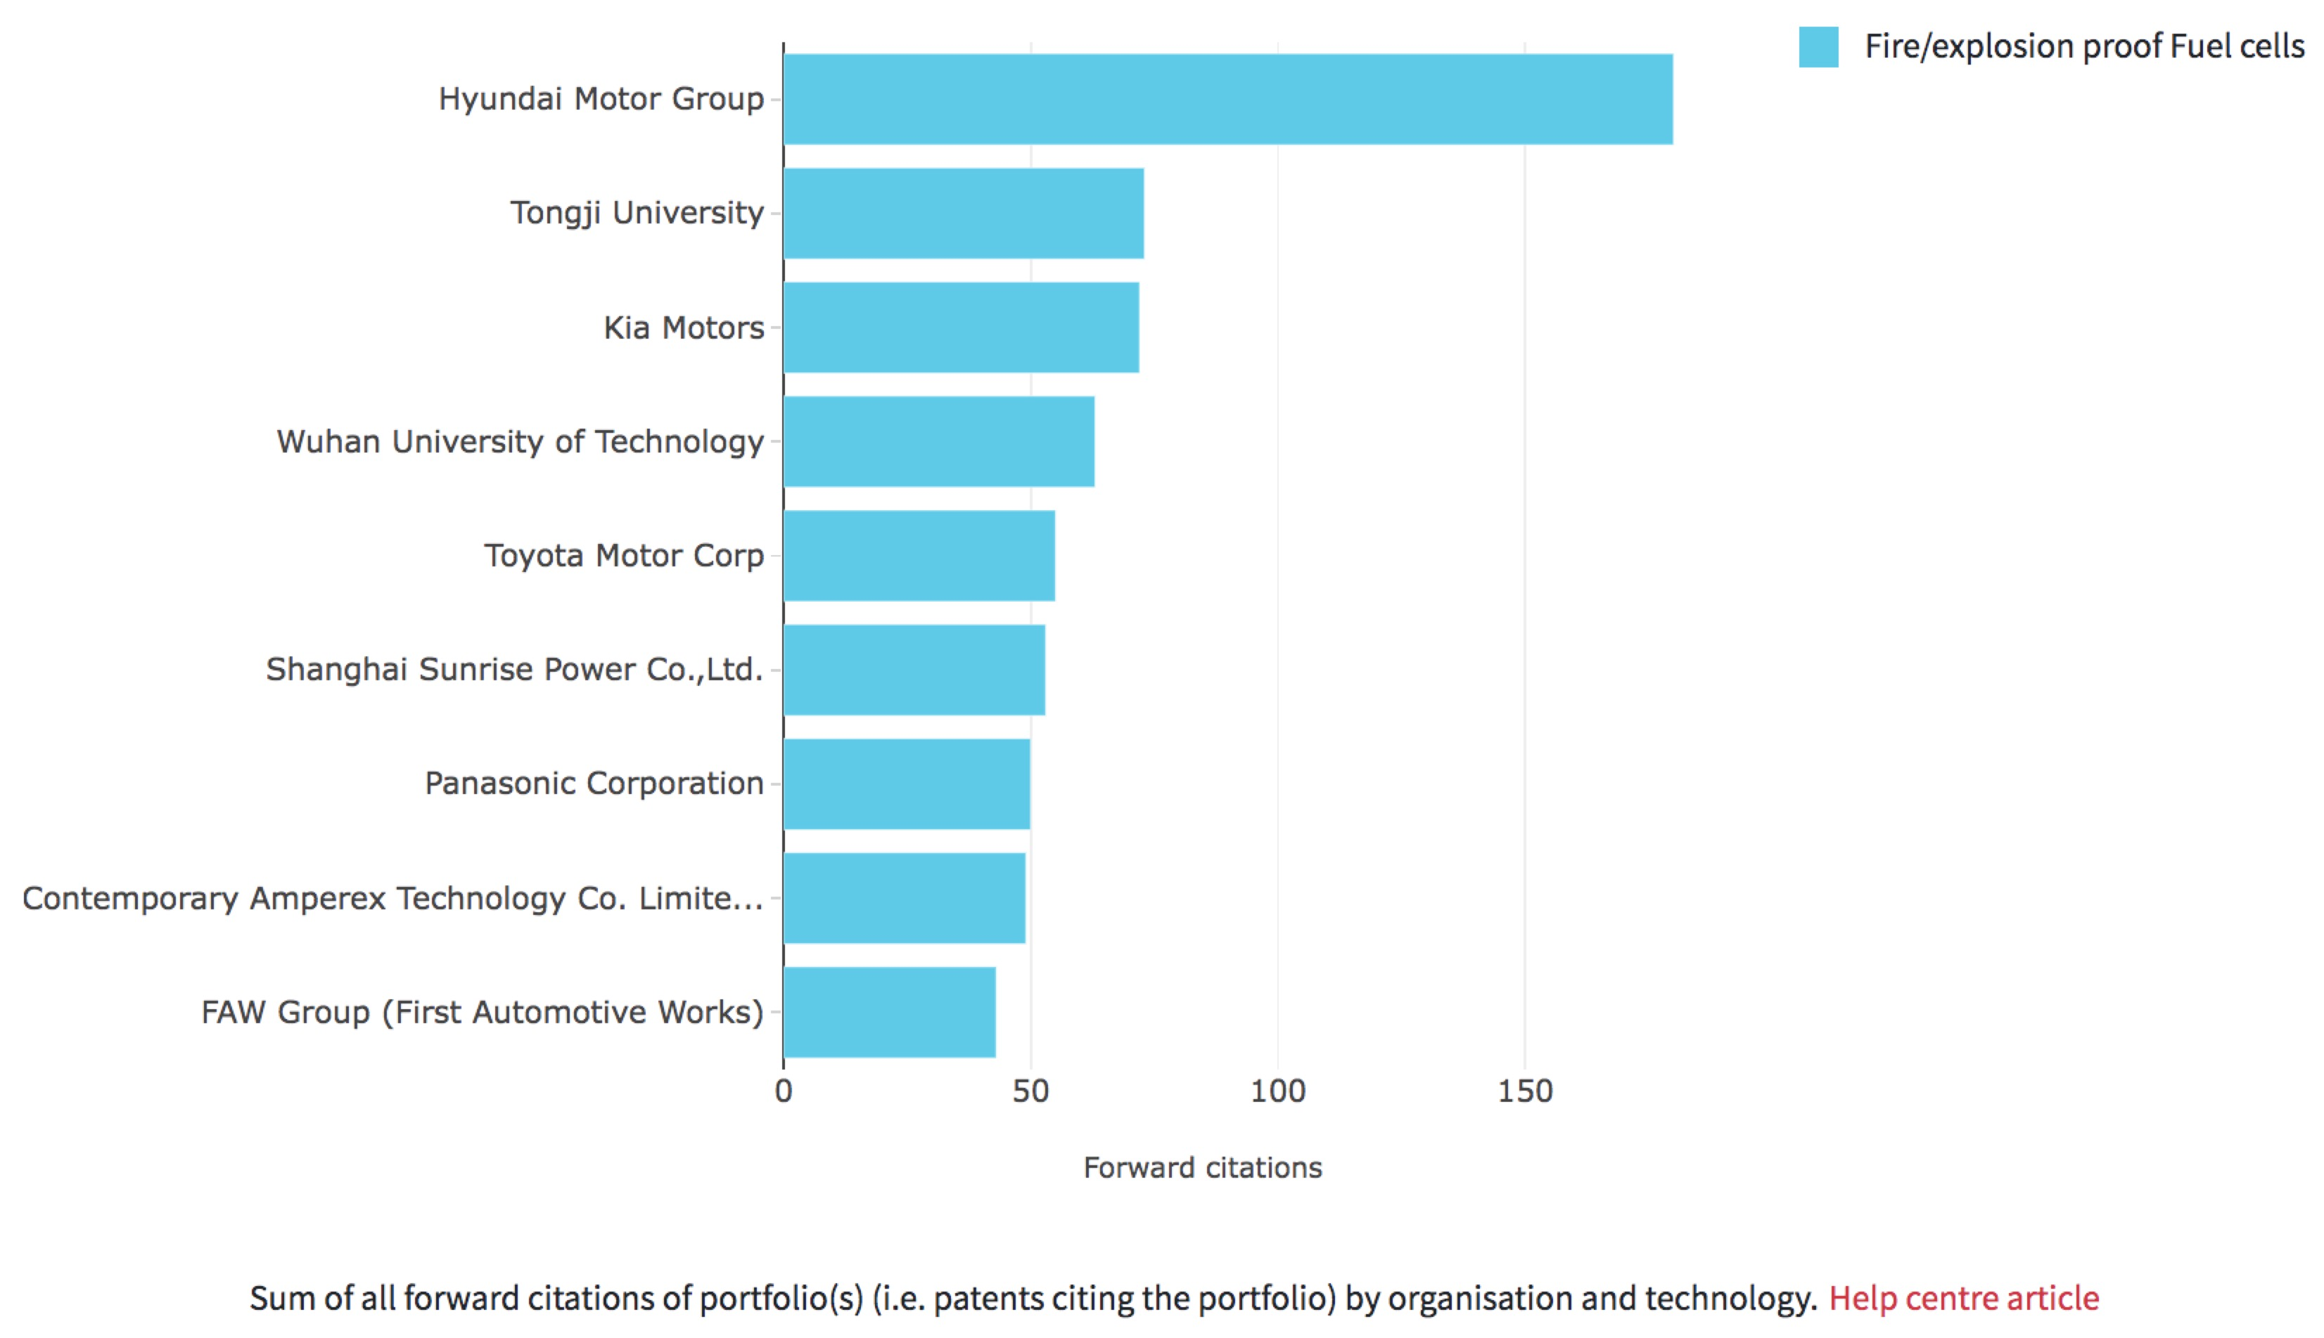
Our partners based on Patents Citations
Priority day in 10 years
Weight: 0.2 | Citation ≥ 600 | 600 > Citation ≥ 340 | 340 > Citation ≥ 300 | 300 > Citation ≥ 200 | 200 > Citation ≥ 100
Backward citation score | 5 | 4 | 3 | 2 | 1
Weight: 0.8 | Citation ≥ 100 | 100 > Citation ≥ 70 | 70 > Citation ≥ 55 | 55 > Citation ≥ 50 | 50 > Citation ≥ 40
Forward citation score | 5 | 4 | 3 | 2 | 1
Figure 1. Sum of all backward citations of portfolio by organization
 | Hyundai | Kia | Toyota | Panasonic | FAW
Total score | 5 | 4 | 3 | 2 | 1
Rank | 1 | 2 | 3 | 4 | 5
*The rank is based more on the number of forward citations and less on the number of backward citations.
Forward citation means fundamentality and originality.
Backward citation presents continuity.
Figure 2. Sum of all forward citations of portfolio by organization

Slide 10
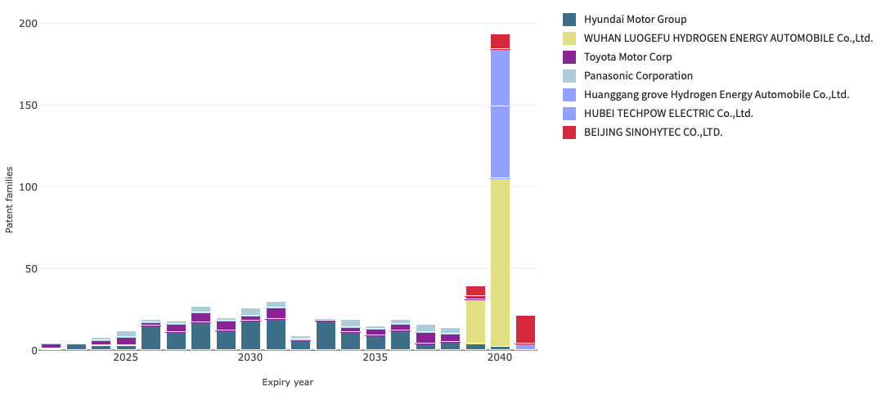
Our partners based on Age of Patent Portfolios
Patent age
Age weight
Num*Weight
Expiry Age (Years) | Score
0~4 | 1
5~8 | 2
9~12 | 3
13~16 | 4
17~20 | 5
Normalize
Expiry date>18 years:
Wuhan Luogefu Hydrogen
Huangang Grove Hydrogen
Hubei Tech
Beijing Sinohytec
Figure 1. Projected number of patent families expiring per year, for each organization. Only considers currently granted patent families and assumes patent families reach a maximum age of 20 years.

Slide 11
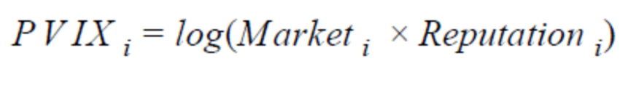
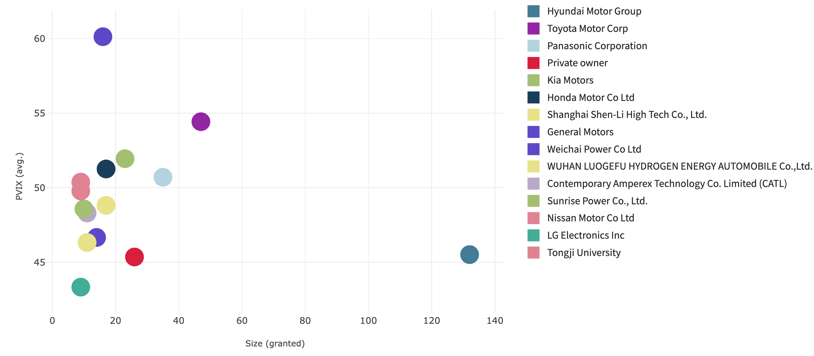
Our partners based on PVIX
PVIX score is based on three components: Family, Market, and Reputation.
General Motors
962
Toyota Motor Corp
2,558
Hyundai Motor Group
6,009
Figure 1. The average PVIX score by organization and size.

Slide 12

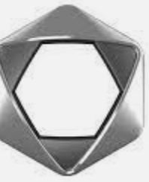


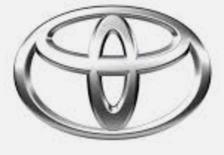
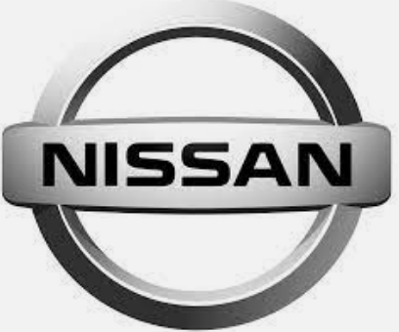



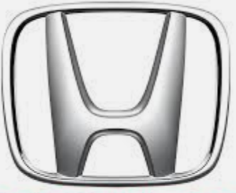


Our possible partners based on above analysis
Faw
General Motors
Wuhan Grove
Kia
Toyota
Toshiba
Nissan Motor
Hyundai
Panasonic
Huanggang grove Hydrogen
Wuhan Luogefu
Hubei Techpow Electric Co., Ltd
Honda
Beijing Sinohytec

Slide 13
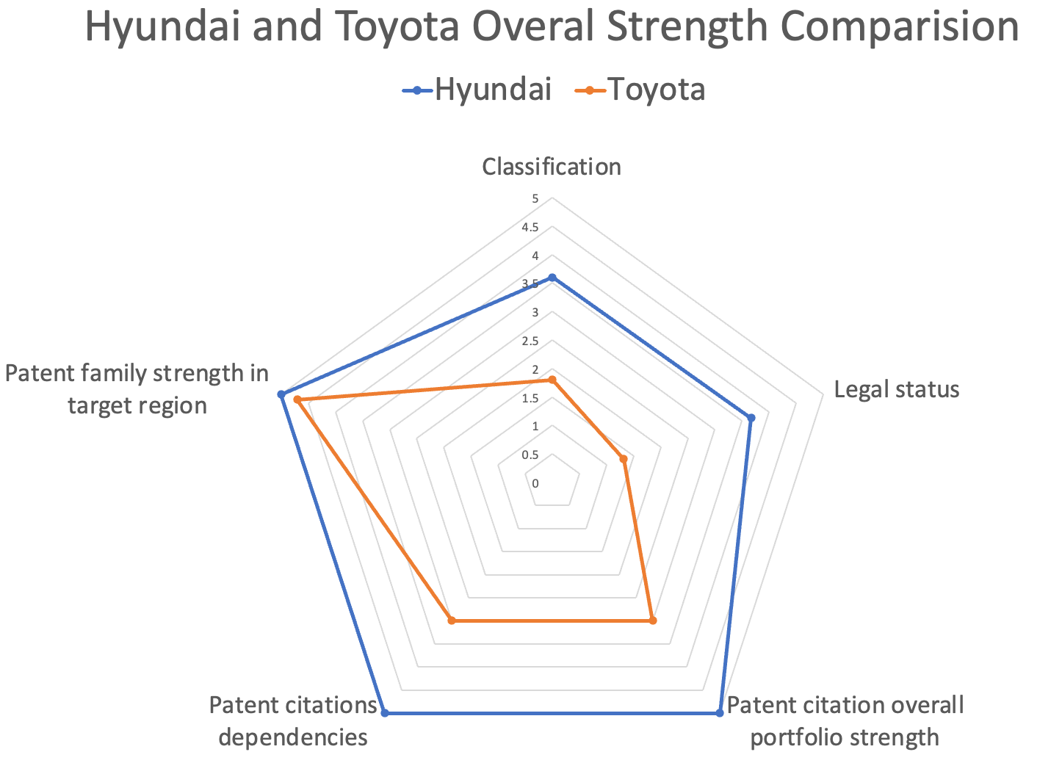
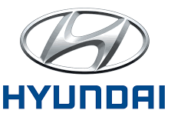
Our suggestion
Comparison | Hyundai | Toyota
Classification | 3.6 | 1.8
Legal status | 3.67 | 1.32
Patent citation overall portfolio strength | 5 | 3
Patent citations dependencies | 5 | 3
Patent family strength in target region | 5 | 4.7
Total Score | 22.27 | 13.82
Most valuable strategic partner

Slide 14
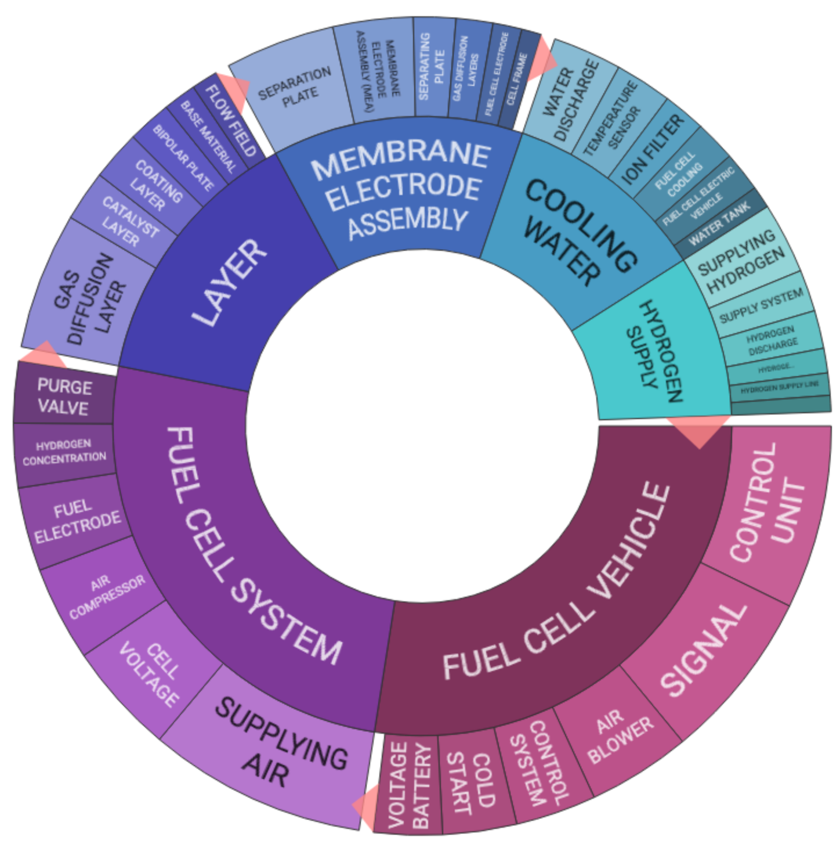

Classification Circle for cooperation
Most relevant points for Cooperation

Slide 15
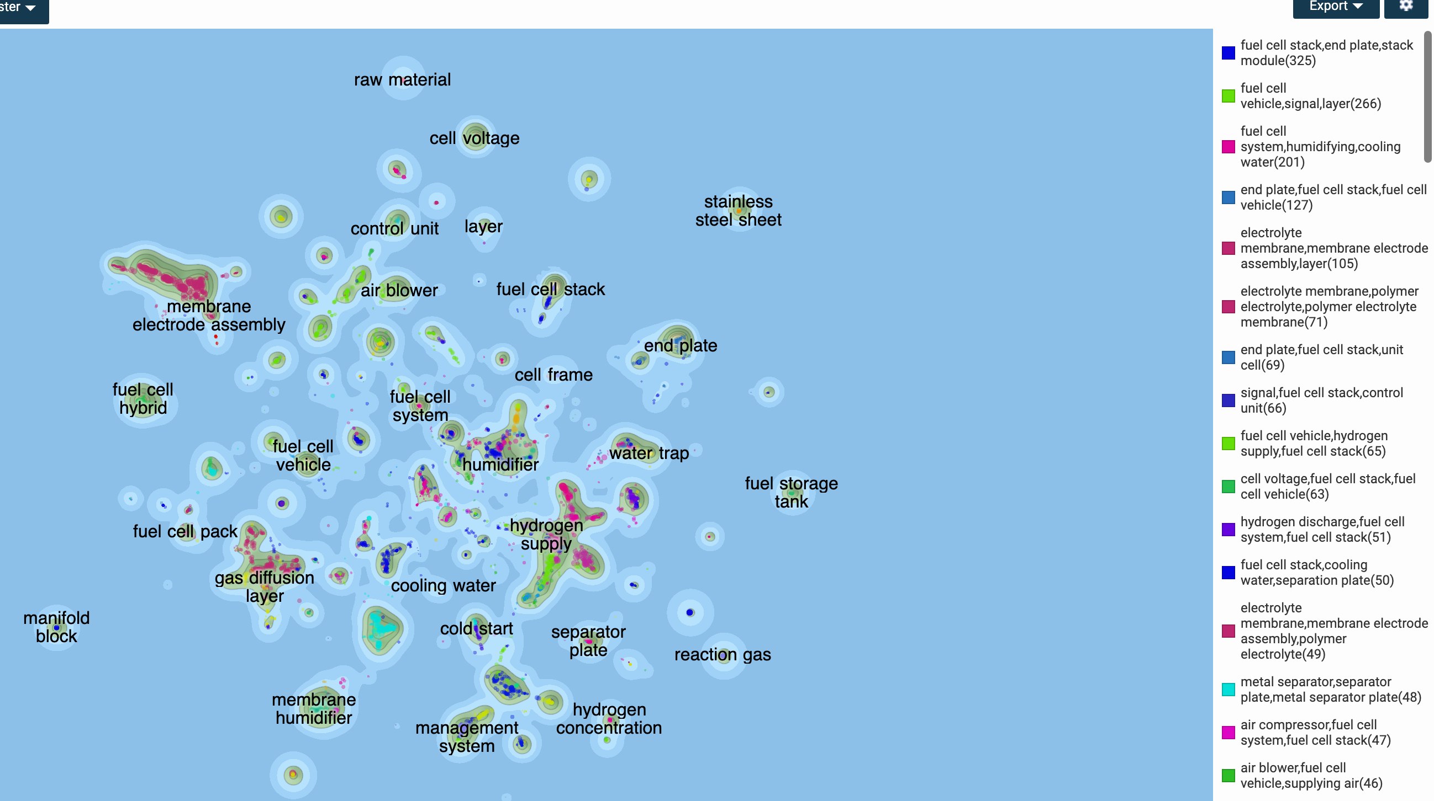
Patents Terrain for Cooperation
Relevant patents distribution
for success in negotiation

Slide 16

Limitations & Challenges
02 Evaluation System
03 Citation Status
Is Self-definition reasonable
Cited by Patent Examiners
Cited by Company itself
Why these patents cited others and are cited by others
01 Analysis Strategy
How about “next” and “Private owners”
e.g., Ballard, a non-top company
06 Still need to read
Find suitable companies
04 Age of patent portfolios
05 Patent Tool
For truly high value patents, 3~4 years of use is equally worthwhile
Errors occur
e.g., Wuhan Luogefu? Or Grove

Slide 17
H₂
Thank you!
Q & A
Post-Market Launch Patent Analysis for Fire-Proofing Hydrogen Cell Vehicles Companies
Dequn Teng, Miaomiao Zou, Chen Ye, Can Cui
2nd Mar 2022

